Slide 1
Roman
Government

Slide 2
Republican
Form of
Government

Slide 3
The Roman government was a republic.

Slide 4
In a republic, citizens can choose their leaders.

Slide 5
The republic was established in 509 B.C. and lasted nearly 500 years.

Slide 6
One difference between the Roman republic and the Greek democracy was that in Greece all men could vote, but in Rome, only men with money and property could vote.

Slide 7
Another difference between the Roman republic and the Greek democracy was that in Greece all men voted on every law and in Rome the wealthy elected representatives to make laws for everyone.

Slide 8
This type of democracy is called a representative democracy.

Slide 9
How was the
Roman
government organized?

Slide 10
Since the Romans did not want one man to make all of the laws, they decided to balance the power of the government between three branches:

Slide 11
the executive branch,
the legislative branch,
and
the judicial branch.

Slide 12
Executive Branch

Slide 13
The two leaders of the executive branch, the consuls, were elected for just one year by the upper class.

Slide 14
They supervised the Senate and ordered the Roman army during wars.

Slide 15
Other members of the executive branch were the tax collectors, mayors, city police, and other people in positions of power in cities.

Slide 16
Legislative Branch

Slide 17
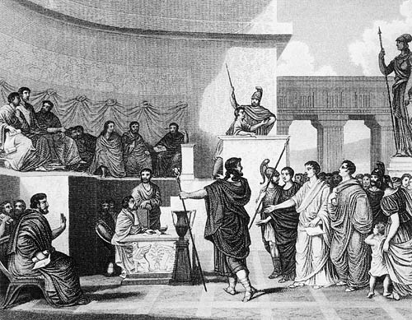

Slide 18
The most powerful part of the legislative branch was the Senate..

Slide 19
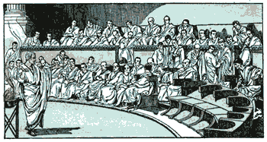

Slide 20
The Senate was a group of about 300 male citizens who owned land.

Slide 21
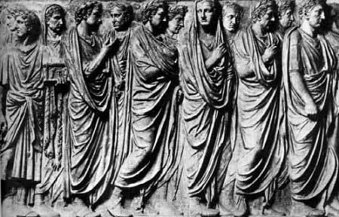

Slide 22
They could tell the consuls how much money they could spend and on what.

Slide 23
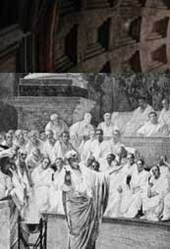

Slide 24
These men were appointed by the consuls.

Slide 25
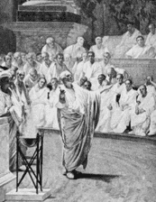

Slide 26
Judicial Branch

Slide 27
The judicial branch had six judges who were elected every two years.

Slide 28
They were in charge of deciding punishments that criminals would receive.

Slide 29
Their job was similar to the job that judges have today in the United States.

Slide 30
Would I have been able to vote in Rome?

Slide 31
In ancient Rome, you were not allowed to vote on laws or elect leaders of the government until you were an adult.

Slide 32
Even then, only men who owned land were allowed to have a say in the laws.

Slide 33
The
Roman
Forum

Slide 34
The forum was the center of political, commercial and judicial life in ancient Rome. The largest buildings were the basilicas, where legal cases were heard.

Slide 35
The Roman Forum Rome Italy - ComPart

Slide 36
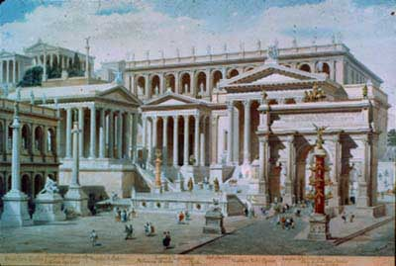

Slide 37
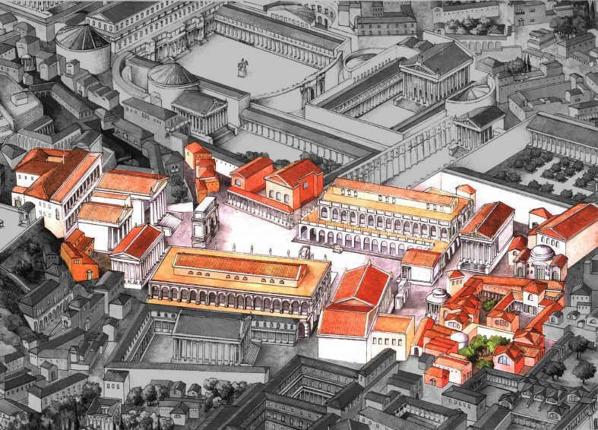

Slide 38
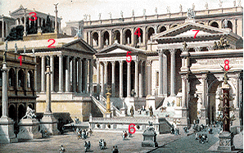
1 = Basilica Julia 2 = Temple of Saturn 3 = Temple of Jupiter Optimus Maximus (on Capitoline hill) 4 = Tabularium (Archive Building) 5 = Temple of Vespasian 6 = Rostra 7 = Temple of Concord 8 = Triumphal Arch of Septimius Severus

